Slide 1

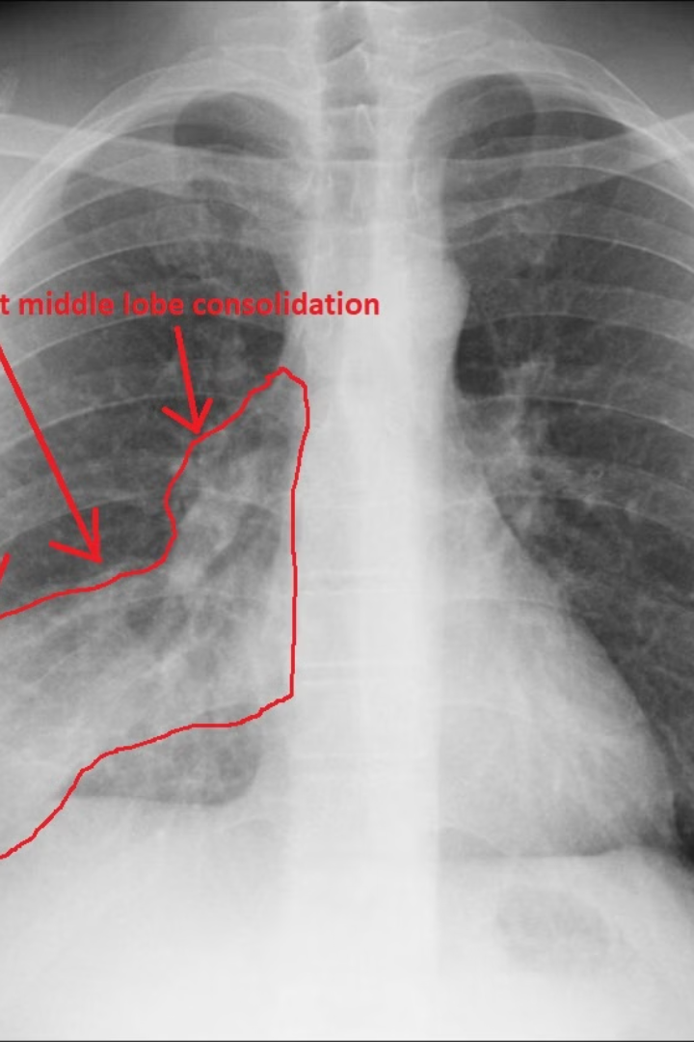
Pneumonia Detection through Chest Scan
Using CNN, Transfer Learning, and Computer Vision Techniques
Department of AIML

Slide 2
What is pneumonia?
Bacterial or Viral Infection
Symptoms
Treatment
Pneumonia is an infection that inflames the air sacs in one or both lungs.
It can cause cough, fever, and difficulty breathing, especially for at-risk individuals.
Antibiotics and antiviral medications are common treatments for pneumonia.
Department of AIML

Slide 3
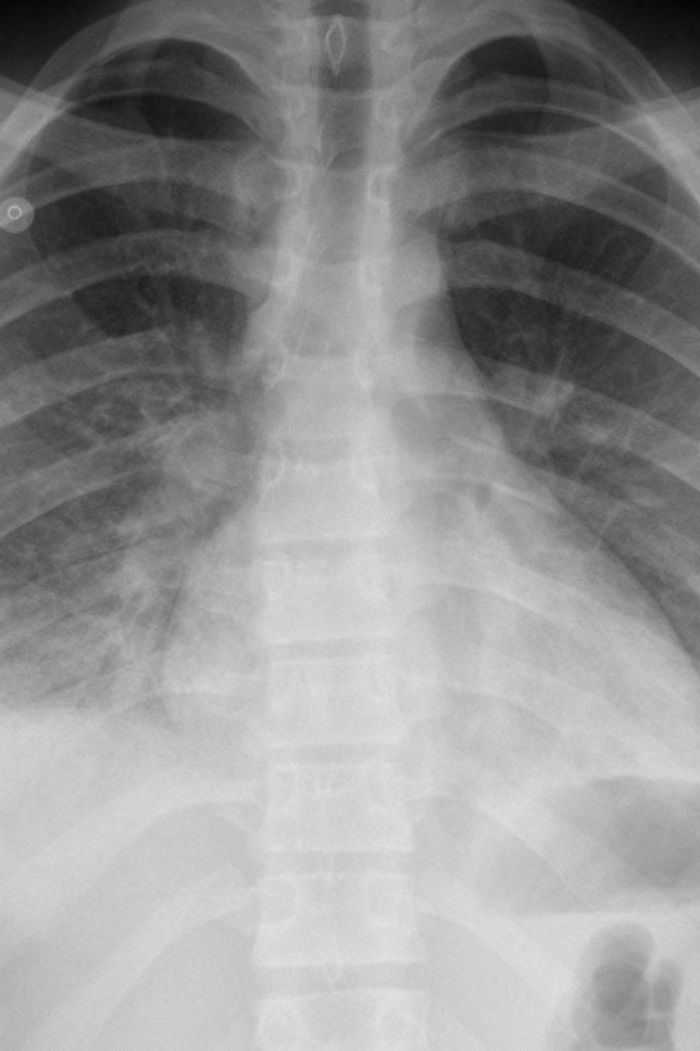
Importance of early detection
Timely Treatment
Early detection leads to prompt treatment and better recovery outcomes for patients.
Prevent Complications
It helps prevent severe complications and reduces the risk of spreading the infection.
Department of AIML

Slide 4


CNN (Convolutional Neural Network)
Pattern Recognition
Deep Learning
CNN can recognize patterns and features in chest scans to identify pneumonia.
It uses deep learning to analyze and differentiate between healthy and infected tissues.
Department of AIML

Slide 5
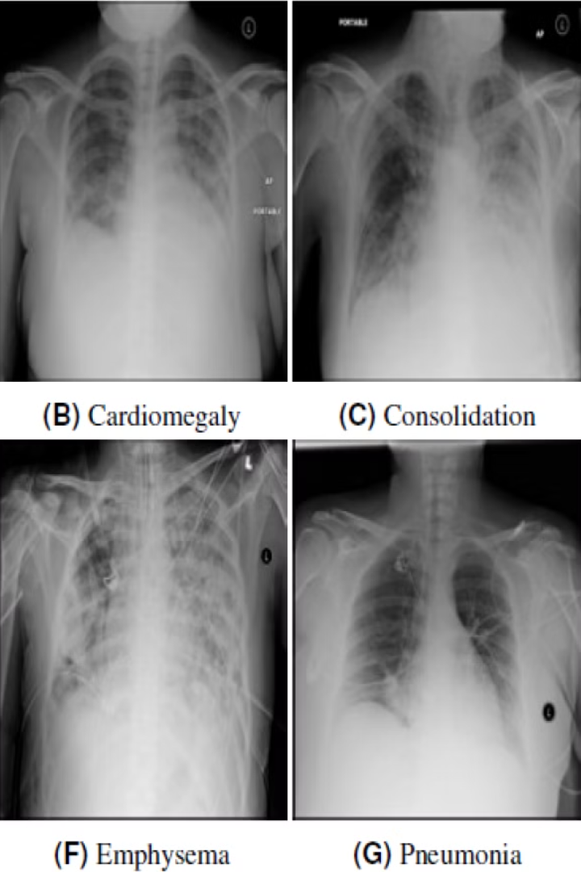
Transfer learning
Knowledge Sharing
Speeds Up Training
Transfer learning allows the model to apply pre-existing knowledge to new tasks.
It accelerates the training process by leveraging features from similar tasks.
Department of AIML

Slide 6
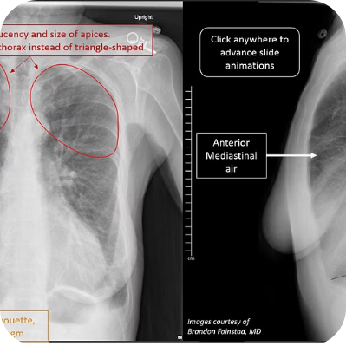
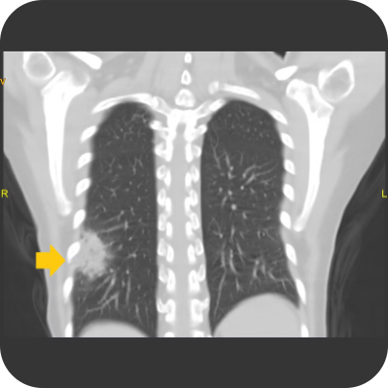
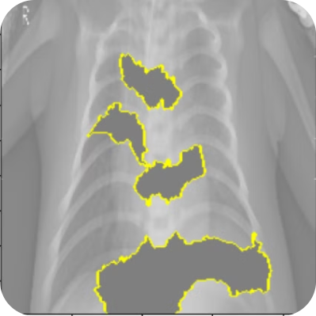
Computer vision techniques
Image Segmentation
Feature Extraction
Classification
Identifying and analyzing key areas in chest scans for accurate diagnosis.
Extracting important visual features from the scans for detailed analysis.
Classifying scans as healthy or infected based on extracted features and patterns.
Department of AIML

Slide 7



Methodology
Dataset Collection
Model Implementation
Evaluation & Testing
Compilation of a diverse set of annotated chest scans for training the models.
Development and application of CNN with transfer learning and computer vision algorithms.
Thorough testing to ensure the accuracy and reliability of the developed solution.
Department of AIML

Slide 8
Conclusion
Advancing Patient Care
Future Possibilities
The integration of CNN, transfer learning, and computer vision is transforming pneumonia detection and diagnosis.
Continuous advancements in AI and medical imaging hold promising potential for enhanced healthcare.
Department of AIML

Slide 9

Thank You for Your Attention!
BY-
SHREYAS H S
BM SOMASHEKAR
RAGHAVENDRA PRASAD G SHETTI
MUTTUSHERY JOHNSON BRIAN
ANJAN SS
We appreciate your time and attention. If you have any questions or would like to learn more about our work, please feel free to reach out to us. We look forward to connecting with you soon!
Department of AIML

